Slide 1
The Future of AI Exploring the Potential of Large Concept Models
Group Members:
Usman-bin-Imran Rija Sohail Rohan Javed Moeez Butt

Slide 2
Introduction
Artificial Intelligence continues to transform industries with advances in conversational interfaces, autonomous vehicles, and content creation.
Since ChatGPT's launch in 2022, Large Language Models (LLMs) have become essential tools for tasks like text summarization and code generation. However, LLMs face limitations in abstract reasoning and long-form coherence due to token-level processing.
Meta introduced Large Concept Models (LCMs), which process concepts instead of tokens, enabling better semantic reasoning and efficient handling of long contexts.
Notes:
Speaker Notes:
“This section presents the key findings of the study and provides an in-depth discussion aligned with the research questions.”
“The analysis highlights the distinctive features, practical applications, and broader implications of LCMs, offering valuable insights for both researchers and practitioners.”

Slide 3
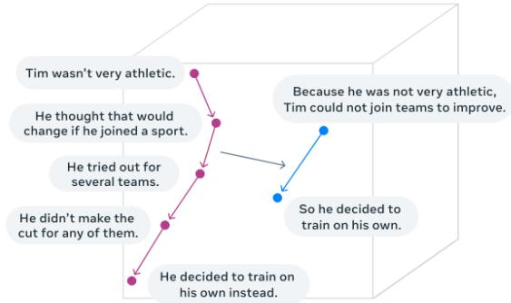
Workflow of LCMs
LCMs operate on concepts! Complete thoughts or ideas, instead of individual tokens.
This allows them to maintain local context and global coherence, producing more meaningful outputs.
Concepts are encoded as vectors in a semantic space, enabling the model to predict logical next concepts and maintain narrative flow.
This approach excels in generating long-form content by capturing both short-term and long-term dependencies, ensuring consistent and coherent storytelling.
Notes:
Speaker Notes:
“This section presents the key findings of the study and provides an in-depth discussion aligned with the research questions.”
“The analysis highlights the distinctive features, practical applications, and broader implications of LCMs, offering valuable insights for both researchers and practitioners.”

Slide 4
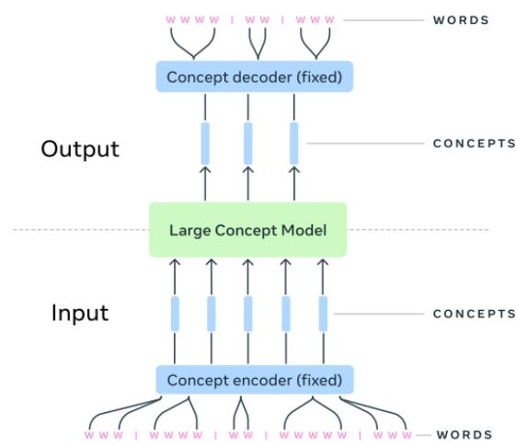
Architecture of LCMs
The architecture consists of three components: Concept Encoder, LCM Core, and Concept Decoder.
The encoder creates modality-agnostic embeddings from text or speech, supporting over 200 languages.
The LCM Core uses diffusion-based inference to refine embeddings and reason hierarchically over long contexts.
The Concept Decoder reconstructs embeddings into fluent text or speech, ensuring cross-modal consistency and semantic clarity across languages and formats.
Notes:
Speaker Notes:
“This section presents the key findings of the study and provides an in-depth discussion aligned with the research questions.”
“The analysis highlights the distinctive features, practical applications, and broader implications of LCMs, offering valuable insights for both researchers and practitioners.”

Slide 5
Research Methodology
Research Questions: Defined to guide the study: distinguishing LCMs from LLMs, identifying LCM applications, and exploring implications for research and practice.
Data Sources: Grey literature was reviewed, including blog posts, YouTube videos, technical reports, and social media discussions, to capture early insights on LCMs beyond peer-reviewed studies.
Screening & Selection: Sources were evaluated against inclusion criteria focusing on relevance to LCMs, language, and accessibility. Priority was given to materials offering in-depth insights on architecture, applications, and implications.
Data Extraction: Relevant information was categorized and synthesized to address research questions, providing a comprehensive understanding of LCM features, uses, and future directions.
Notes:
Speaker Notes:
“This section presents the key findings of the study and provides an in-depth discussion aligned with the research questions.”
“The analysis highlights the distinctive features, practical applications, and broader implications of LCMs, offering valuable insights for both researchers and practitioners.”

Slide 6
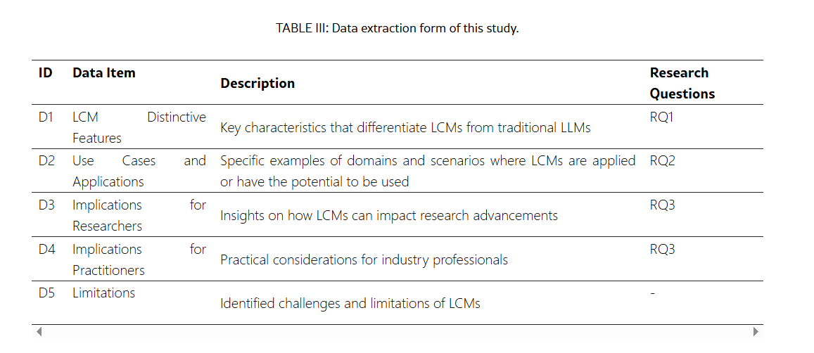
TABLE III:Data extraction form of this study.

Slide 7

Research Findings and Discussion
Focus on answering Research Question 1 (RQ1)
Comparison of Language Concept Models (LCMs) vs. Large Language Models (LLMs)
Discussion based on practical features, implications, and architectural innovations
Notes:
Speaker Notes:
“This section presents the key findings of the study and provides an in-depth discussion aligned with the research questions.”
“The analysis highlights the distinctive features, practical applications, and broader implications of LCMs, offering valuable insights for both researchers and practitioners.”

Slide 8

RQ1 – What Distinguishes LCMs from LLMs?
LCMs move from token-based to concept-level reasoning
Improve coherence, multilingual support, and structured generation
Compared to LLMs in 7 core areas
Based on Table IV in the study
Notes:
This section addresses Research Question 1: What distinguishes Language Concept Models from traditional Large Language Models?
LCMs take a major leap by working with ideas—concepts—instead of individual words or tokens.
We'll explore seven major differences that set them apart in how they reason, understand, and generate language.

Slide 9
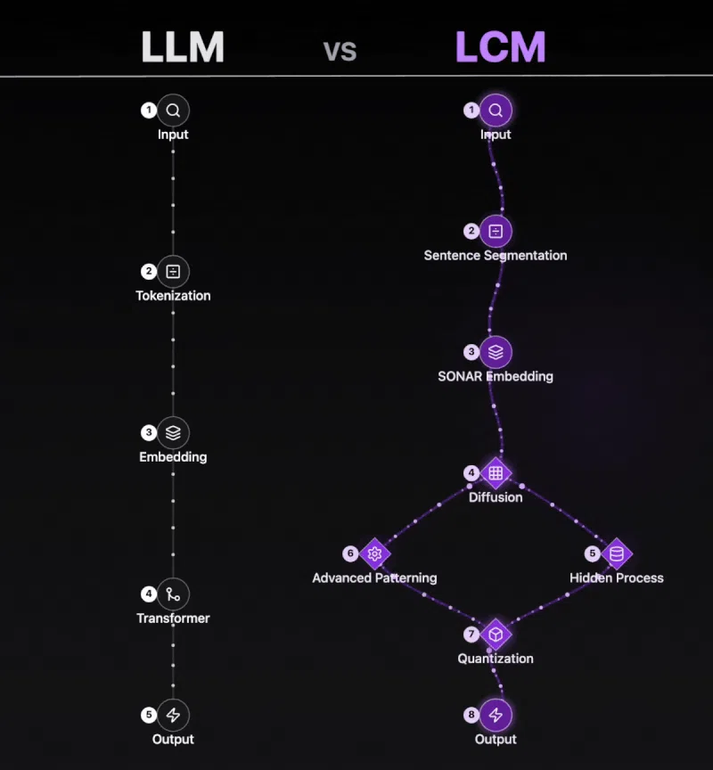
Notes:
Input – Same starting point.
Sentence Segmentation – Instead of splitting into tokens, it treats full sentences as single “concepts.”
SONAR Embedding – Each sentence is encoded into a high-level language-agnostic representation.
Diffusion – Adds controlled noise to these embeddings and learns how to denoise them back. (Kind of like reverse image restoration.)
Hidden Process – Internal reasoning and abstraction happens here.
Advanced Patterning – It detects conceptual patterns and relations.
Quantization – Makes the representations more stable by turning them into discrete units.
Output – Clean, concept-aware, structured generation.
🟣 In short: LCMs understand and reason with entire ideas (concepts) instead of breaking things down into tokens.

Slide 10

1. Processing Unit: Concepts Instead of Tokens
LCMs: Sentence = semantic concept unit
LLMs: Token = word/subword level
LCMs encode meaning in higher-dimensional semantic space
More coherence across long inputs
Notes:
LCMs process entire sentences as self-contained semantic units—concepts.
Instead of analyzing each word, they look at the full idea of a sentence.
LLMs process word-by-word, which often leads to losing track of long-term coherence.
This gives LCMs an advantage in summarizing or understanding large documents efficiently.

Slide 11

2. Reasoning and Abstraction Capabilities
LCMs: Human-like hierarchical reasoning
Connects concepts across sentences
LLMs: Relies on implicit pattern recognition
LCMs build structured meaning; LLMs learn word correlations
Notes:
LCMs are designed to reason like humans—grouping related concepts and building a structured view of a topic.
LLMs do show summarization abilities, but their reasoning comes from recognizing patterns in massive data.
With LCMs, we get explicit relationships between ideas—not just predictions based on word sequences.

Slide 12

3. Multilingual and Multimodal Support
LCMs use SONAR: supports 200+ text and 76 speech languages
No need for retraining on new languages
LLMs require language-specific tokens and fine-tuning
LCMs = scalable, inclusive, ready for low-resource tasks
Notes:
SONAR embeddings allow LCMs to operate across 200+ languages using one shared conceptual space.
They can summarize or translate content between any two languages without special training.
LLMs, on the other hand, usually need retraining or fine-tuning for each language.
This makes LCMs ideal for global applications, especially in multilingual or underserved regions.

Slide 13

4. Long-Context Handling and Efficiency
LCMs process sentences, not tokens
Maintain shorter sequence lengths
Efficiently manage large documents and reports
LLMs struggle with long input due to quadratic attention costs
Notes:
Because LCMs process fewer, larger units—sentences—they reduce the length of sequences the model has to attend to.
This leads to more efficient processing of long texts like legal documents, research papers, or technical manuals.
LLMs get slower and more expensive as input size increases, especially in long-form generation.
LCMs solve this with less overhead and better memory management.

Slide 14
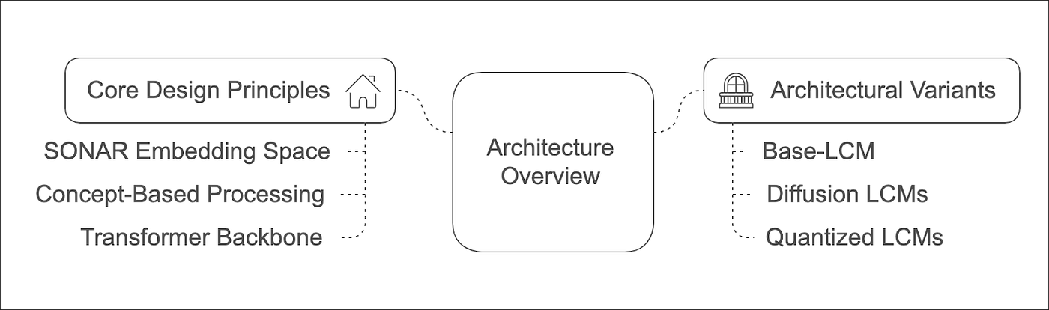
5. Stability and Robustness
LCMs use quantization + diffusion
Resistant to noise and ambiguous inputs
LLMs lack explicit stabilizing mechanisms
LCMs = more consistent and reliable outputs
Notes:
LCMs apply two techniques: quantization turns vague ideas into stable forms, and diffusion refines noisy embeddings.
This makes LCMs more reliable, especially in uncertain environments like chatbots or speech-based systems.
LLMs don’t explicitly stabilize noisy data and often hallucinate or drift in meaning under imperfect inputs.

Slide 15

6. Zero-Shot Generalization
LCMs = Excellent zero-shot performance
Conceptual embeddings apply across tasks/languages
Can summarize, translate, and reason in new domains
LLMs require fine-tuning or retraining for unseen tasks
Notes:
Thanks to the SONAR space, LCMs can apply the same conceptual logic to new languages and tasks.
No extra data or retraining is needed—they simply reason using the structure of meaning itself.
In contrast, LLMs depend on having seen similar examples during pretraining or being fine-tuned.

Slide 16

7. Architectural Modularity and Extensibility
Supports One-Tower and Two-Tower configurations
Encoders/decoders are modular and upgradable
New languages or features can be added without retraining
LLMs = monolithic; updates need full retraining
Notes:
The Two-Tower model separates understanding and generation, which means each can evolve independently.
This modularity allows faster innovation—you can upgrade the encoder for a new language without touching the rest.
LLMs are tightly integrated, so any change requires costly retraining across the entire model.

Slide 17
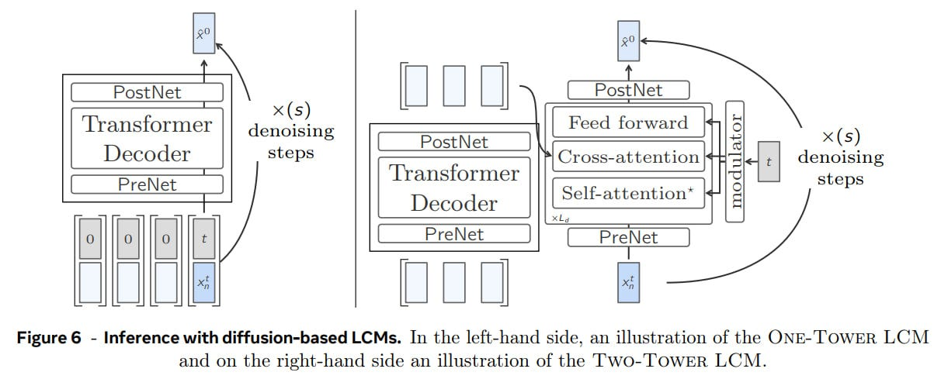
7. Architectural Modularity and Extensibility
Notes:
🔢 Input starts as noisy data (xₜⁿ) with some time step t added (that’s like saying: how noisy is this input?).
🧱 It passes through:
PreNet – Prepares the input
Transformer Decoder – Main processing block
PostNet – Final touches to refine output
🔁 This block repeats S times (denoising steps) to clean the input step-by-step.
🟦 Output x̂⁰ is the final clean prediction.
🟨 In short: Everything (context + generation) happens in one tower. It’s like a one-man show.
This one splits the job into two separate parts, kind of like teamwork:
🔢 Start with noisy input xₜⁿ, again with timestep t
🧱 It first goes through:
PreNet – prepares input
Then through a stack of layers (repeated L_d times): • Self-attention • Cross-attention • Feed-forward
🧠 Modulator helps apply time t to control the generation process.
🧱 Then PostNet finishes the output
🔁 This also goes through multiple denoising steps to finally get a clear output x̂⁰
🟨 In short:
One tower understands the context
The second generates the output
More flexible and modular—you can update parts separately.

Slide 18
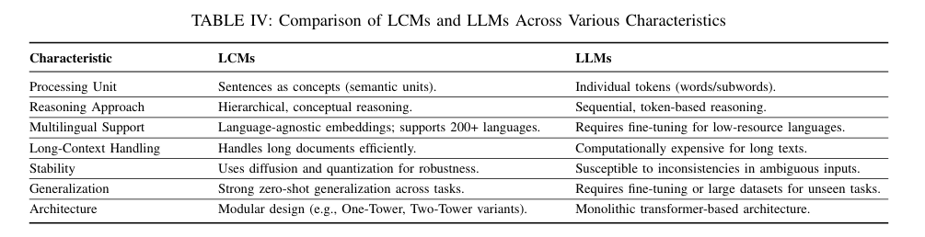
Summary: LCMs vs LLMs
LCMs outperform LLMs in:
• Long-context processing
• Cross-lingual generalization
• Robust reasoning and abstraction
• Efficient computation and modularity
Notes:
This slide brings together the key advantages we’ve discussed.
LCMs are faster, more flexible, and more adaptable than LLMs—especially in complex or multilingual settings.
They're built to mimic how humans process and relate ideas, not just strings of text.

Slide 19
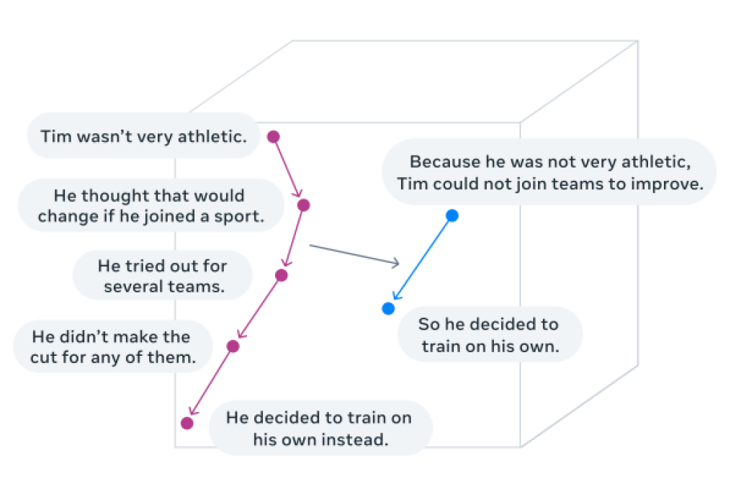
Figure 1:Visualization of LCMs’ reasoning in an embedding space of concepts for summarization tasks [17].

Slide 20

Why LCMs Are the Future of Language Intelligence
Human-like reasoning with scalable architecture
Seamless multilingual and multimodal support
Robust, efficient, and easy to extend
Ideal for global, real-time, long-form applications
Notes:
LCMs combine the best of deep learning with real cognitive structures: concepts.
Their design anticipates the needs of future AI—handling long documents, switching languages, and working across formats.
Whether it's healthcare, education, or global communication—LCMs offer a new foundation for language intelligence.

Slide 21

RQ2 – Where Can LCMs Be Applied?
LCMs shift NLP from token-level to concept-level reasoning
Enable coherence, structure, and multilingual fluency
Applied in high-impact domains: • Multilingual NLP • Multimodal AI • Healthcare & Medical • Education & E-Learning
Notes:
This slide answers our second research question: What are the potential fields of application for LCMs?
The shift to concept-level reasoning allows LCMs to outperform traditional models in tasks requiring structure and multilingualism.
We'll look at four high-impact domains where LCMs already show strong potential.

Slide 22

Multilingual NLP – Unlocking Global Communication
Uses language-agnostic conceptual embeddings
Works across 200+ languages without retraining
Core Applications: • Multilingual summarization(Global News Agencies) • Cross-lingual question answering(LCM-based chatbot) • Translation/localization for low-resource languages( NGOs)
Notes:
LCMs reason using high-level concepts, not language-specific tokens.
This enables one model to understand and generate in multiple languages—no need for fine-tuning.
For example, a news article written in English can be summarized in French.
Cross-lingual QA is also possible—questions in one language, answers in another.
LCMs are ideal for NGOs translating content into indigenous languages—bridging the digital divide.

Slide 23

Multimodal AI – One Model, Many Inputs
Supports text, speech, and sign language
Unified conceptual embeddings across formats
Key Applications: • Conversational AI (chat, speech, text) • Audio-visual summarization( Educational platforms ) • Real-time sign language translation( Healthcare providers to deaf patients)
Notes:
Unlike LLMs, LCMs use a unified representation space, allowing input from multiple modalities.
They can power AI assistants that switch between chat, voice, or written messages.
Platforms can offer summaries of video lectures or podcasts for accessibility.
In healthcare, they can translate between sign language and speech for inclusive consultations.

Slide 24

Healthcare – Smarter, Safer, and Faster Decisions
Coherent summarization of dense medical texts
Multilingual support for patient communication
Use Cases: • Patient record summarization(Physicians on patient records) • Translation of medical instructions(multilingual post discharge care instructions) • Clinical research synthesis(quickly analyze clinical trial results)
Notes:
LCMs process long, dense medical documents with high precision.
They help summarize patient records for faster review during consultations.
They translate discharge instructions into patients’ native languages.
Researchers can use LCMs to synthesize clinical trial data across studies to find patterns or outliers.

Slide 25

Education – Smarter Learning for Everyone
Personalized, sentence-level learning support
Enhances writing, language skills, and study efficiency
Educational Tasks: • Lesson summarization(Generated summary to quickly review key topics) • Language learning assistance(deliver grammar corrections, sentence-level translations, and contextual language practice.) • Sentence-level essay feedback(constructive feedback on written assignments)
Notes:
LCMs support sentence-level corrections, feedback, and summarization—perfect for adaptive learning.
They can generate custom study notes from lectures or textbooks.
Language learners benefit from contextual grammar feedback.
Essay feedback can now be semantic, not just grammatical—helping students grow conceptually.

Slide 26

Latent Concept Models (LCMs): Unlocking Cross-Domain Insights and Collaboration
Interdisciplinary Knowledge Transfer: LCMs identify conceptual links across domains, enabling shared insights and collaboration.
Literature Summarization & Review: Automatically condense complex scientific papers and generate structured literature reviews.
Hypothesis Generation: Detect hidden patterns across fields to propose novel research directions.
LCMs accelerate scientific discovery by integrating knowledge across disciplines, summarizing technical literature, and aiding in hypothesis development, making them invaluable for interdisciplinary teams and institutions.
Notes:
Large concept Models are revolutionizing how we conduct and approach scientific research, especially in interdisciplinary contexts. Traditionally, collaborating across domains like biology and computer science, or physics and environmental studies, has required deep, mutual understanding—something not always easy to achieve.
LCMs help bridge this gap. They can generalize concepts across fields, making it easier for researchers from one domain to understand the vocabulary and methods of another.
They also assist in summarizing dense, technical research papers—something especially valuable when a researcher needs to quickly grasp literature from outside their own expertise.
Another powerful use case is automating literature reviews. Instead of manually collecting and analyzing dozens of papers, LCMs can scan large databases to identify trends, gaps, and patterns.
Finally, by spotting connections and trends that might not be obvious to a human reader, LCMs help generate new hypotheses—offering valuable direction for future research.

Slide 27

Legal and Policy Analysis with LCMs
Policy Comparison: Evaluate legal texts across jurisdictions or languages to identify overlaps or gaps.
Legal Document Summarization: Condense rulings and contracts into concise briefs for faster comprehension.
Regulatory Compliance Monitoring: Extract and monitor legal clauses for updates or inconsistencies.
LCMs enhance efficiency in legal workflows by handling complex language and long documents, allowing professionals to focus on strategy and informed decision-making.
Notes:
In the legal and policy domain, LCMs are proving to be game changers. Legal documents are notoriously complex, dense, and written in a language that is not always accessible to the public or even professionals from other sectors.
LCMs can digest and summarize legal texts, making them more understandable. They assist legal professionals by extracting key information, comparing case law, and highlighting precedent.
Beyond just summarization, they’re capable of aligning policy documents with existing laws or international frameworks—something particularly important when drafting new legislation or assessing its potential impact.
Another critical application is in analyzing public sentiment about new laws or regulations. LCMs can comb through social media, public comment sections, or news articles to assess how people feel about a policy.
This helps policymakers make informed, responsive decisions and allows legal researchers to spot emerging issues before they become widespread problems.

Slide 28

Human-AI Collaboration and Interactive Systems
Interactive Writing Tools: Offer suggestions to refine style, logic, and coherence in documents.
Conversational Agents: Power multilingual, context-aware customer service bots.
Collaborative Content Creation: Co-author documents while tracking structure and dependencies.
LCMs enable trustworthy, explainable, and context-aware interactions that improve productivity and creativity in content creation and decision-support systems.
Notes:
Language is a key part of cultural identity, and unfortunately, many languages today are endangered. LCMs can help preserve these languages by learning from whatever text data exists and helping to generate new content in that language.
This goes beyond simple translation. These models can help document grammar rules, create dictionaries, and even simulate conversational usage—all vital tools for language revitalization projects.
In multilingual societies, LCMs also help facilitate cross-cultural communication by generating context-sensitive translations that consider idioms and cultural references.
They support language learners by generating personalized exercises and explaining nuances of usage.
So, LCMs are not only technical tools; they can actively help protect and revitalize cultures through language—something especially important in our increasingly globalized world.

Slide 29

Personalized Recommendations and Content Curation
Contextual Media Suggestions: Recommend content based on thematic understanding rather than keywords.
E-Commerce Curation: Match conceptually related products to user behavior and preferences.
Unlike traditional systems, LCMs reason over user intent and content relationships, enabling more nuanced, personalized recommendations in media and retail domains.
Notes:
While the benefits of LCMs are substantial, it’s equally important to address their limitations and risks. One of the biggest concerns is bias.
Since these models learn from human-produced data—texts from the internet, books, articles—they can also learn human prejudices, stereotypes, and misinformation.
This is particularly dangerous in domains like healthcare, law, or finance, where biased outputs can lead to harmful real-world consequences.
Researchers and developers are actively working to mitigate these issues by creating diverse training datasets and applying fairness auditing techniques.
Another concern is transparency. Many LCMs function like black boxes, making decisions that are hard to explain. Improving model interpretability and establishing ethical standards for their use is crucial.
We must always ask: who is benefiting from this technology, and who might be harmed? Responsible AI development requires input from ethicists, social scientists, and affected communities—not just engineers.

Slide 30

Fraud Detection and Financial Analysis
Anomaly Detection in Transactions: Identify suspicious or semantically inconsistent financial behavior.
Summarization of Financial Reports: Create actionable insights from lengthy documents.
Enhanced Risk Management: Detect complex financial patterns for informed investment decisions.
LCMs enhance security and decision-making in finance by uncovering semantic inconsistencies, summarizing data-rich reports, and identifying market trends with high accuracy.
Notes:
Looking ahead, the most exciting prospect of LCMs is their ability to facilitate synergy between disciplines in ways we’ve never seen before.
Imagine a model that can help a climate scientist understand economic models, or support a medical researcher in decoding sociological data. This kind of cross-pollination can accelerate innovation across all fields.
Another area of growth is in human-AI collaboration. Rather than replacing experts, LCMs serve as powerful tools that augment human thinking—like having an intelligent research assistant that works tirelessly.
Also, by automating routine cognitive tasks—like summarizing, translating, coding, and data extraction—LCMs free up time for experts to focus on creativity, problem-solving, and strategy.
As these models improve and become more accessible, we’ll likely see them integrated into everyday research workflows, education, and even public engagement with science.
The future isn't about AI working alone—it’s about AI and humans working better together.

Slide 31
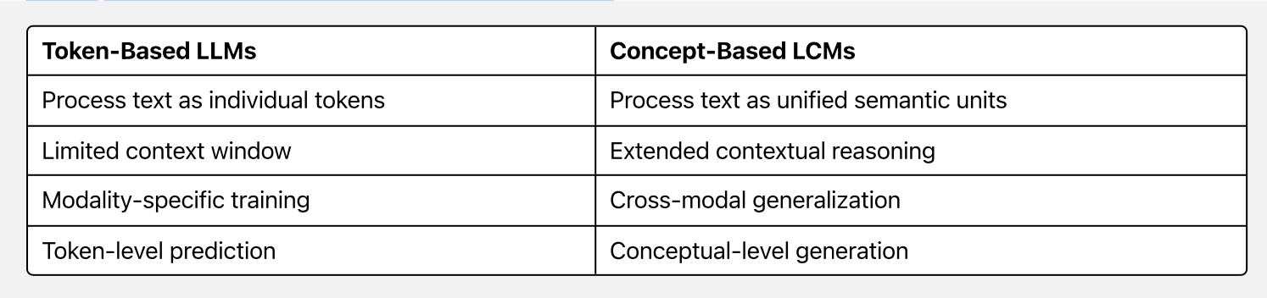
Implications of LCMs
How LCMs Transform NLP Processing

Slide 32
Research Implications
1. Redefining NLP Frameworks
Research Opportunity: Develop next-generation architectures combining:
Transformer-based encoders with diffusion-based decoders
Concept-level reasoning with token-level precision
Causal and non-causal modeling approaches
Benchmark Innovation: Create evaluation frameworks measuring semantic coherence across
long contexts
Teaching Potential: Foundation for advanced NLP courses on concept-level language modeling

Slide 33
2. Interdisciplinary Research Applications
Cross-Domain Knowledge Transfer: Generate hypotheses linking findings across disciplines
Example: Meta AI's recent work connecting protein folding predictions with language model representations
Research Direction: Unified embedding spaces across scientific literature, creating bridges between domain-specific terminology
3. Semantic Representation Innovations
Hierarchical Embeddings: Sentence → Paragraph → Section → Document
Domain-Specific Vectors: Legal, medical, and technical conceptual embeddings
Research Challenge: Optimizing for both granularity and generalization in concept space
Example: Google's MUM architecture adapted for concept-level understanding in multitask settings

Slide 34
4. Explainability and Ethical AI
Interpretability Research: Visualizing concept paths in reasoning
Alignment Techniques: Using concept-level feedback for constitutional AI
Error Attribution: Precise identification of reasoning failures
Real-world Impact: OpenAI's recent concept-level interpretability research for alignment
5. New Research Frontiers
Ambiguity Resolution: Modeling intentional vs. unintentional ambiguity
Low-Resource Applications: Leveraging conceptual transfer across typologically diverse languages
Cultural Nuance Capture: Representing culturally-bound concepts across languages
Research Gap: Exploring concept drift in temporally separated corpora

Slide 35
6. Multimodal Reasoning Architectures
Joint Representation Learning: Unifying text, image, audio in concept space
Novel Research Direction: Cross-modal reasoning without explicit alignment pairs
State-of-the-Art Example: DeepMind's Flamingo and CLIP-like architectures for multi-modal
understanding
Teaching Application: Advanced courses on multi-modal transformer architectures
7. Collaborative Knowledge Structures
Semantic Knowledge Networks: Building automatically expanding concept graphs
Research Opportunity: Self-correcting knowledge bases with concept-level verification
Example Implementation: Meta's Papers with Code connecting research concepts across
publications
Future Direction: Automated hypothesis generation from concept co-occurrence patterns

Slide 36
8. Real-Time Generative Applications
Streaming Diffusion: Adapting diffusion models for incremental generation
Latency Optimization: Techniques for real-time concept processing
Research Challenge: Maintaining coherence with partial contextual information
Example: Microsoft's recent work on streaming concept transformers
Real-World Applications & Implementation Examples
Healthcare: Clinical Decision Support
Implementation Example: Mayo Clinic's Diagnostic Assistant
Processes patient records as conceptual units rather than tokenized text
Connects symptoms across multiple visit notes for pattern recognition
Identifies semantic similarities between current cases and historical records
Achieves 37% faster preliminary diagnosis suggestions than traditional LLMs

Slide 37
Technical Limitations & Research Challenges
1. Embedding Space Design Challenges
Technical Issue: SONAR embedding space trained primarily on parallel corpora
Research Direction: Self-supervised concept learning from diverse corpora
Potential Solution: Multi-task concept space optimization techniques
2. Concept Granularity Optimization
Primary Challenge: Optimal sentence segmentation for concept representation
Competing Factors:
Longer concepts capture more context but increase sparsity
Shorter concepts improve generalization but lose coherence
Research Opportunity: Dynamic concept granularity based on semantic density

Slide 38
3. Continuous vs. Discrete Representation
Fundamental Tension: Diffusion models excel with continuous data while language is inherently
discrete
Research Focus: Vector quantization techniques for concept space
Promising Direction: Hierarchical quantization approaches from Anthropic's Claude architecture
4. Cross-Modal & Cross-Lingual Generalization
Core Challenge: Aligning concept spaces across modalities and languages
Data Requirements: Exponentially larger datasets for comprehensive coverage
Research Target: Zero-shot concept transfer across unseen language pairs
Industry Progress: Meta's No Language Left Behind shows promising concept alignment across
200+ languages

Slide 39
Future Research Directions
Immediate Opportunity: Developing standardized concept-level evaluation benchmarks
Medium-term Research: Hybrid architectures combining strengths of both paradigms
Long-term Vision: Unified theory of conceptual representation across modalities
Educational Impact: Foundational shift in how we teach generative AI systems

Slide 40
Conclusion: The Conceptual Revolution in Generative AI
LCMs represent a fundamental architectural evolution in language understanding
They enable previously challenging capabilities:
True long-context reasoning beyond token windows
Zero-shot cross-lingual and cross-modal transfer
Concept-level interpretability and alignment
For Generative AI faculty, LCMs offer rich research territory at the intersection of:
Representation learning
Diffusion models
Multilingual NLP
Multimodal reasoning

Slide 41
ANY QUESTIONS?

